Slide 1

“Student Performance Prediction”
Project Presentation
MITU21BTCS0288:- Krisha Aggrawal
MITU21BTCS0457:- Raj Aryan
MITU21BTCS0632 :- Sudhamsu Rawlo
Guided by – Suruchi Deshmuk
Prof. Dr. Ganesh Pathak (HOD, Computer Science & Engineering)
Prof. Dr. Sunil Dingare(HOD, Aerospace Engineering)
Department of Computer Science & Engineering, MITSoC, Loni Kalbhor

Slide 2
Outline
Introduction
Problem Statement
Objectives
Concepts & Methods
Literature Review
Identification of gaps & scope of work
Implementation
Reference
Q&A
Department of Computer Science & Engineering, MITSoE, Loni Kalbhor

Slide 3
Introduction
The project's fundamental aim is to harness the power of machine learning to
understand the intricate web of factors that influence student performance. With a focus on predictive analytics, it seeks to develop a model capable of anticipating academic outcomes with precision.
By scrutinizing a myriad of student attributes, encompassing historical academic records, attendance patterns, examination results, and other relevant
parameters, this project endeavors to provide a holistic view of student performance.
Department of Computer Science & Engineering, MITSoE, Loni Kalbhor

Slide 4
Problem Statement
In the realm of education, the diverse range of student behaviors, learning patterns, and academic requirements often pose a challenge for educators and students to improve their employability.
Objectives
Develop a machine learning model to accurately predict student
performance in upcoming semester exams.
● Create an educational application that offers personalized feedback and
recommendations to motivate and assist students.
● Enable real-time monitoring of student performance throughout the
semester, allowing for timely interventions.
● Implement an adaptive learning system that tailors educational content to
individual student needs.
● Enhance the overall quality of the educational experience by leveraging
technology to improve academic outcomes.
● Support educators and institutions in proactively addressing academic
challenges and fostering student success.
Department of Computer Science & Engineering, MITSoE, Loni Kalbhor

Slide 5
4. Concepts and Methods
Python, scikit-learn, pandas, and machine learning are powerful tools and
technologies that are integral to your project, "Student Performance Prediction.”
Random Forest Regressor:
Random Forest is an ensemble learning technique that combines multiple
decision trees to make more accurate predictions.
MLP Regressor (Multi-Layer Perceptron):
● MLP is a type of artificial neural network with multiple layers of
interconnected neurons.
K-Nearest Neighbor (KNN):
● KNN is an instance-based learning algorithm that makes predictions based
on the similarity between data points.
J48 Decision Tree Regressor:
● J48 is a decision tree-based algorithm designed for regression tasks.
● It's known for its interpretability and simplicity in modeling complex
relationships.
Department of Computer Science & Engineering, MITSoE, Loni Kalbhor

Slide 6
Artificial Neural Network:
● Neural networks, particularly feedforward neural networks, have been
widely used for regression tasks. Support Vector Machine (SVM):
● SVM is a powerful algorithm for regression tasks that aims to find the optimal hyperplane to minimize prediction error.

Slide 7
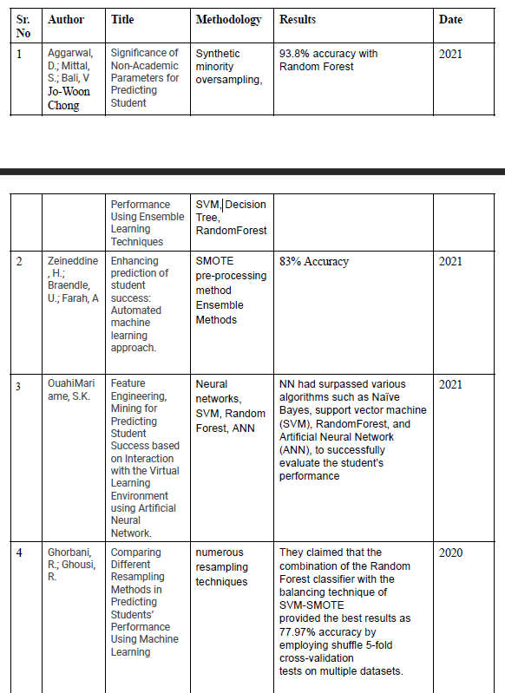
5. Literature Survey
Department of Computer Science & Engineering, MITSoE, Loni Kalbhor

Slide 8
6. Tools and Languages
Python
VS code
Scikit-learn
Jupyter Notebook
Pandas
Department of Computer Science & Engineering, MITSoE, Loni Kalbhor

Slide 9
7. Process and Architecture
Step 1: Data Collection and Feature Understanding
● Collect Historical Data: Gather historical data from educational
institutions, including student demographics, past performance,
attendance, and other relevant features.
Step 2: Model Development
● Choose Algorithms: Select machine learning algorithms suitable for
regression tasks, such as Random Forest, Support Vector Machine, and
Neural Networks, based on the dataset and problem complexity.
● Model Training: Train the selected models on the historical dataset using a
portion for training and another for validation.
Step 3: Cloud Integration and Real-Time Data
● Cloud Infrastructure: Set up a cloud-based environment (e.g., AWS,
Azure, Google Cloud) for deploying and serving machine learning models.
● API Development: Create APIs to enable real-time data interaction with
the cloud-based system. The app interface should send student data to
these APIs.
Department of Computer Science & Engineering, MITSoE, Loni Kalbhor

Slide 10
Step 4: Deployment and Monitoring
● Model Deployment: Deploy the trained models on the cloud infrastructure,
making them accessible for real-time predictions.
● Real-Time Predictions: The app interface sends student data to the cloud,
which triggers the models to provide real-time predictions regarding
student performance and recommendations.
Step 5: Scaling and Maintenance
● Scalability: Ensure that the system can scale efficiently to handle a
growing user base and increasing data volume.

Slide 11
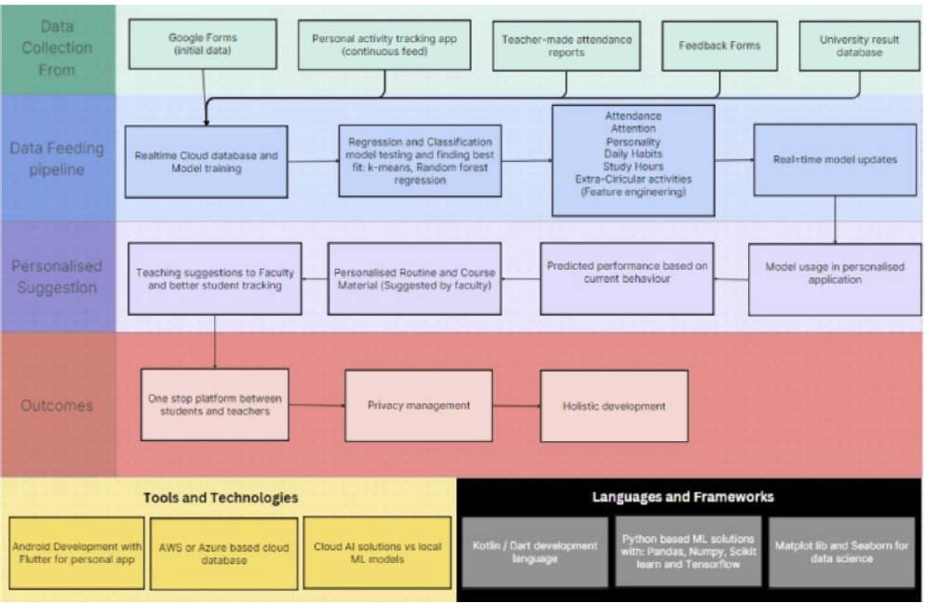

Slide 12
Identification of gaps & scope of work
Identification of Gaps
The current methodology of prediction student performances is still mostly dependent on historic data, monitoring real-time data and making the system pro-efficient against guess work or cheating can be very challenging.
Students may provide guess work answers
Students may cheat
Historical data may be incorrect (incorrect age, hiding gap years)
The syllabus changes regularly
There is a continuous need of improvement and update in the data
Scope of Work
● Data Collection and Analysis: The project involves gathering and
analyzing a wide range of student data, including historical academic
records, attendance, and assessment results.
● Machine Learning Model Development: The scope includes developing
a machine learning model that can predict student performance accurately
based on the collected data.
● Educational Application Development: The project encompasses the
creation of an educational application that provides personalized feedback
and recommendations to students and educators.
Department of Computer Science & Engineering, MITSoE, Loni Kalbhor

Slide 13
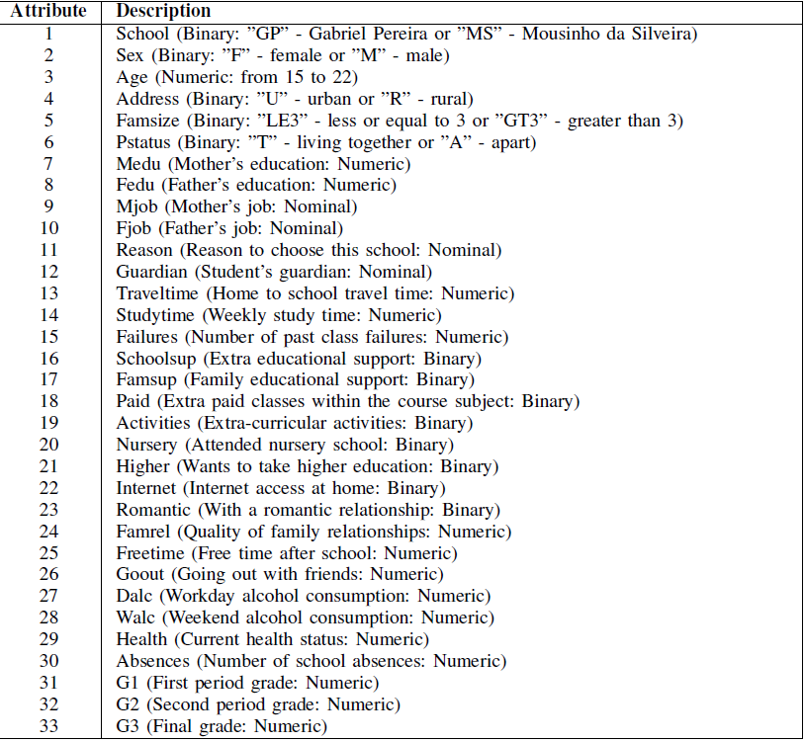
8. Implementation
Department of Computer Science & Engineering, MITSoE, Loni Kalbhor

Slide 14
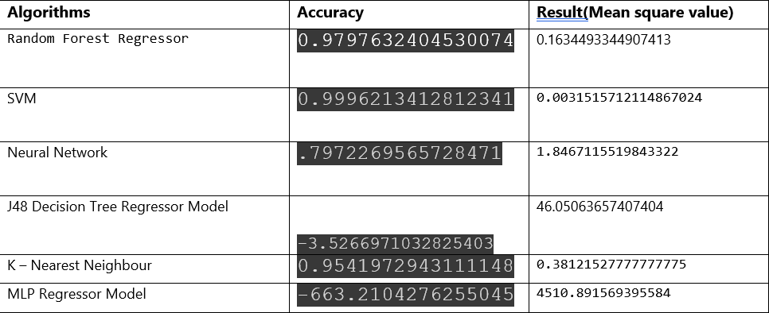
9. Results
Department of Computer Science & Engineering, MITSoE, Loni Kalbhor

Slide 15
10. Conclusion and Future Work
In this study, we embarked on a journey to enhance student performance
prediction through the application of various machine learning algorithms. Our focus was
on regression algorithms, including Random Forest Regressor, Support Vector Machine
(SVM), Neural Network, J48 Decision Tree Regressor, K-Nearest Neighbor (KNN), and
MLP Regressor, each assessed using Mean Squared Error (MSE) values. Additionally, we
delved into classification algorithms with a similar comprehensive approach.
Department of Computer Science & Engineering, MITSoE, Loni Kalbhor

Slide 16
References
[1] Hernández-Blanco, A.; Herrera-Flores, B.; Tomás, D.; Navarro-Colorado, B. (2019).
A systematic review of deep learning approaches to educational data mining.
Complexity 2019, 2019, 1306039. [CrossRef]
[2] Bengio, Y.; Lecun, Y.; Hinton, G. (2021). Deep Learning for AI. Commun. ACM
2021, 64, 58–65. [CrossRef]
[3] Almarabeh, H.; Shatnawi, M.; Yasin, M.B.; Hmeidi, I. (2020). Measuring and
Enhancing the Performance of Undergraduate Student Using Machine Learning
Tools. In Proceedings of the 2020 11th International Conference on Information and
Communication Systems (ICICS), Copenhagen, Denmark, 24–26 August 2020; pp.
261–265.
[4] Wakelam, E.; Jefferies, A.; Davey, N.; Sun, Y. (2020). The potential for student
performance prediction in small cohorts with minimal available attributes. Br. J.
Educ. Technol. 2020, 51, 347–370. [CrossRef]
[5] Zeineddine, H.; Braendle, U.; Farah, A. (2021). Enhancing prediction of student
success: Automated machine learning approach. Comput. Electr. Eng. 2021, 89,
106903. [CrossRef]
[6] OuahiMariame, S.K. (2021). Feature Engineering, Mining for Predicting Student
Success based on Interaction with the Virtual Learning Environment using Artificial
Neural Network. Ann. Rom. Soc. Cell Biol. 2021, 25, 12734–12746.
[7] Reddy, P.; Reddy, R. (2021). Student Performance Analyser Using Supervised
Learning Algorithms. Available online: https://easychair.org/publications/preprint/QhZK
(accessed on 4 August 2021).
Department of Computer Science & Engineering, MITSoE, Loni Kalbhor

Slide 17
Questions
Department of Computer Science & Engineering, MITSoE, Loni Kalbhor

Slide 18
Thank You
Department of Computer Science & Engineering, MITSoE, Loni Kalbhor

